Slide 1
Machine Learning
In Data Analytics

Slide 2
What is Machine Learning
Machine learning is a growing technology which enables computers to learn automatically from past data.
Machine learning uses various algorithms for building mathematical models and making predictions using historical data or information.
it is being used for various tasks such as image recognition, speech recognition, email filtering, Facebook auto-tagging, recommender system, and many more.
In the real world, we are surrounded by humans who can learn everything from their experiences with their learning capability, and we have computers or machines which work on our instructions. But can a machine also learn from experiences or past data like a human does? So here comes the role of Machine Learning.
Machine Learning is said as a subset of artificial intelligence that is mainly concerned with the development of algorithms which allow a computer to learn from the data and past experiences on their own. The term machine learning was first introduced by Arthur Samuel in 1959. We can define it in a summaryzed way as:
With the help of sample historical data, which is known as training data, machine learning algorithms build a mathematical model that helps in making predictions or decisions without being explicitly programmed. Machine learning brings computer science and statistics together for creating predictive models. Machine learning constructs or uses the algorithms that learn from historical data. The more we will provide the information, the higher will be the performance.

Slide 3
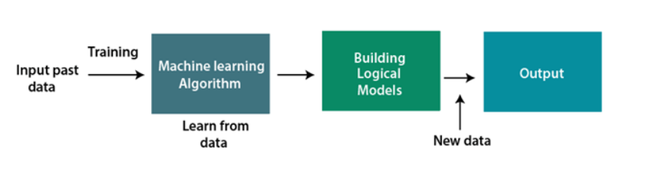
How does Machine Learning work
A Machine Learning system learns from historical data, builds the prediction models, and whenever it receives new data, predicts the output for it. The accuracy of predicted output depends upon the amount of data, as the huge amount of data helps to build a better model which predicts the output more accurately.
Suppose we have a complex problem, where we need to perform some predictions, so instead of writing a code for it, we just need to feed the data to generic algorithms, and with the help of these algorithms, machine builds the logic as per the data and predict the output. Machine learning has changed our way of thinking about the problem. The below block diagram explains the working of Machine Learning algorithm

Slide 4
Features of Machine Learning:
Machine learning uses data to detect various patterns in a given dataset.
It can learn from past data and improve automatically.
It is a data-driven technology.
Machine learning is much similar to data mining as it also deals with the huge amount of the data.

Slide 5
Need for Machine Learning
The need for machine learning is increasing day by day. The reason behind the need for machine learning is that it is capable of doing tasks that are too complex for a person to implement directly. As a human, we have some limitations as we cannot access the huge amount of data manually, so for this, we need some computer systems and here comes the machine learning to make things easy for us.
We can train machine learning algorithms by providing them the huge amount of data and let them explore the data, construct the models, and predict the required output automatically. The performance of the machine learning algorithm depends on the amount of data, and it can be determined by the cost function. With the help of machine learning, we can save both time and money.
The importance of machine learning can be easily understood by its uses cases, Currently, machine learning is used in self-driving cars, cyber fraud detection, face recognition, and friend suggestion by Facebook, etc. Various top companies such as Netflix and Amazon have build machine learning models that are using a vast amount of data to analyze the user interest and recommend product accordingly.

Slide 6
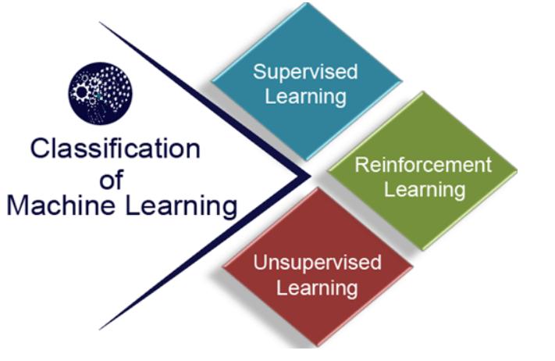
Types of Machine Learning algorithms
Supervised learning
Unsupervised learning
Reinforcement learning

Slide 7
1) Supervised Learning
Supervised learning is a type of machine learning method in which we provide sample labeled data to the machine learning system in order to train it, and on that basis, it predicts the output.
The system creates a model using labeled data to understand the datasets and learn about each data, once the training and processing are done then we test the model by providing a sample data to check whether it is predicting the exact output or not.
The goal of supervised learning is to map input data with the output data. The supervised learning is based on supervision, and it is the same as when a student learns things in the supervision of the teacher. The example of supervised learning is spam filtering.
Supervised learning can be grouped further in two categories of algorithms:
Classification
Regression

Slide 8
Example
For example, a human child is shown a cat and told so. Now even when the child sees a completely different cat among others, it will still identify it as a cat. The same method is employed here.
Supervised algorithms require a data scientist or data analyst with machine learning skills to provide both input and desired output.
We first train the model with the lots of training data(inputs & targets) and then with new data and the logic we got before we predict the output.
Speaking mathematically, supervised learning is where you have both input variables (X) and
output variables(Y) and can use an algorithm to derive the mapping function from the input to the output.
The mapping function is expressed as Y = f(X).
The intent is to train the function so such an extent that whenever we have any new input data (x) that you can predict the output variables (Y) for that given set of data.

Slide 9
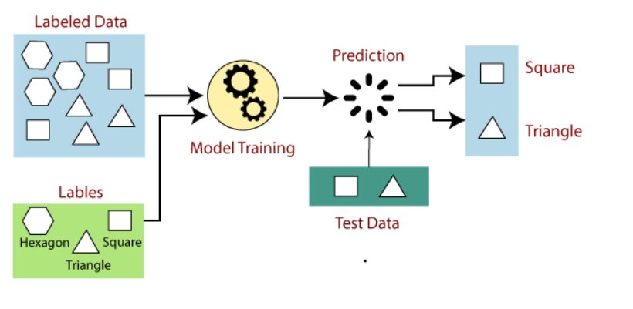
Diagramatic Representation
Suppose we have a dataset of different types of shapes which includes square, rectangle, triangle, and Polygon. Now the first step is that we need to train the model for each shape.
If the given shape has four sides, and all the sides are equal, then it will be labelled as a Square.
If the given shape has three sides, then it will be labelled as a triangle.
If the given shape has six equal sides then it will be labelled as hexagon.
Now, after training, we test our model using the test set, and the task of the model is to identify the shape.
The machine is already trained on all types of shapes, and when it finds a new shape, it classifies the shape on the bases of a number of sides, and predicts the output.

Slide 10
Steps Involved in Supervised Learning:
First Determine the type of training dataset
Collect/Gather the labelled training data.
Split the training dataset into training dataset, test dataset, and validation dataset.
Determine the input features of the training dataset, which should have enough knowledge so that the model can accurately predict the output.
Determine the suitable algorithm for the model, such as support vector machine, decision tree, etc.
Execute the algorithm on the training dataset. Sometimes we need validation sets as the control parameters, which are the subset of training datasets.
Evaluate the accuracy of the model by providing the test set. If the model predicts the correct output, which means our model is accurate.

Slide 11
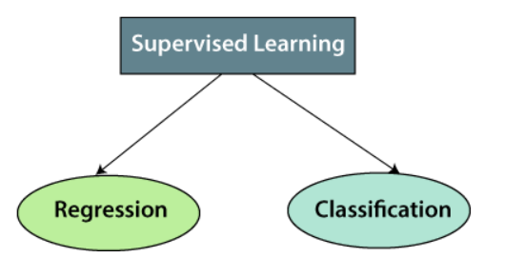
Types of supervised Machine learning Algorithms:
1.Classification:
To predict the outcome of a given sample where the output variable is in the form of categories or
groups.
Examples include labels such as “male” and “female”, “spam“ and “no spam”, “sick” and
“healthy”, etc.
2. Regression:
To predict the outcome of a given sample where the output variable is in the form of real values.
Examples include real-valued labels denoting the “amount of rainfall”, “the height of a person”,
etc.

Slide 12
2) Unsupervised Learning
Unsupervised learning is a learning method in which a machine learns without any supervision.
The training is provided to the machine with the set of data that has not been labeled, classified, or categorized, and the algorithm needs to act on that data without any supervision. The goal of unsupervised learning is to restructure the input data into new features or a group of objects with similar patterns.
In unsupervised learning, we don't have a predetermined result. The machine tries to find useful insights from the huge amount of data. It can be further classifieds into two categories of algorithms:
Clustering
Association

Slide 13
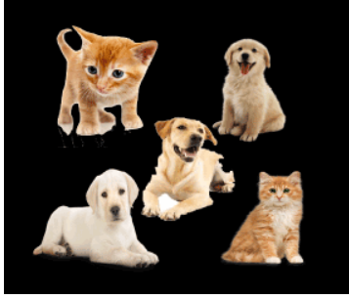
Example
For example, suppose we give an image having both cats and dogs to the machine that it has never seen. Thus, the machine has no idea about the features of dogs and cats and so, it can’t categorize it in dogs and cats.
However, the machine can easily categorize the pictures into two parts.
One part may contain all pictures having cat, while the other part may contain all the pictures having cats in it.
Here, the machine didn’t learn anything before, means no training data or examples.

Slide 14
Why use Unsupervised Learning?
Below are some main reasons which describe the importance of Unsupervised Learning:
Unsupervised learning is helpful for finding useful insights from the data.
Unsupervised learning is much similar as a human learns to think by their own experiences, which makes it closer to the real AI.
Unsupervised learning works on unlabeled and uncategorized data which make unsupervised learning more important.
In real-world, we do not always have input data with the corresponding output so to solve such cases, we need unsupervised learning.

Slide 15
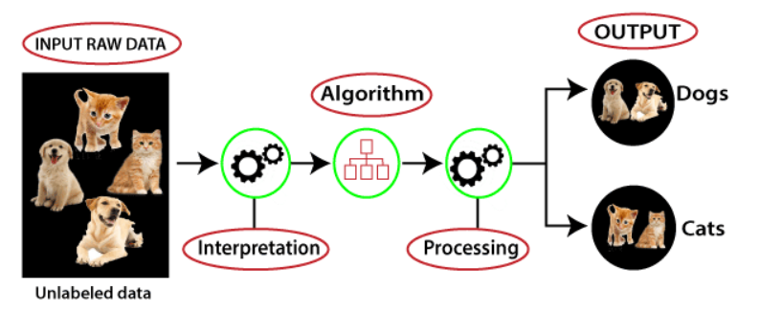
Working of Unsupervised Learning
Here, we have taken an unlabeled input data, which means it is not categorized and corresponding outputs are also not given.
Now, this unlabeled input data is fed to the machine learning model in order to train it.
Firstly, it will interpret the raw data to find the hidden patterns from the data and then will apply suitable algorithms such as k-means clustering, Decision tree, etc.
Once it applies the suitable algorithm, the algorithm divides the data objects into groups according to the similarities and difference between the objects.

Slide 16
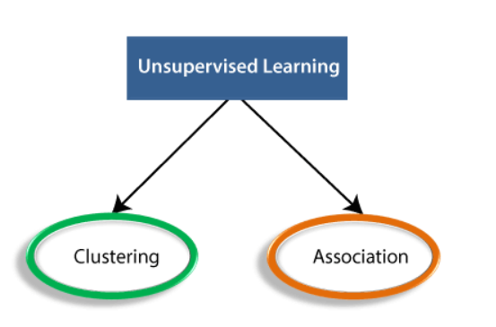
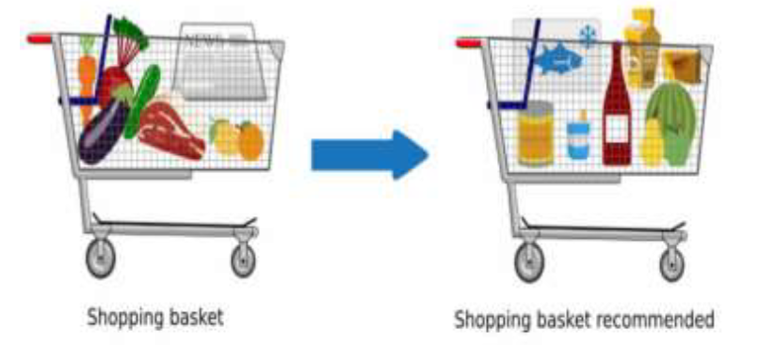
Types of Unsupervised Learning Algorithm:
1. Association:
▪ To discover the probability of the co-occurrence of items in a collection. It is extensively
used in market-basket analysis.
▪ An association rule learning problem is where you want to discover rules that describe
large portions of your data, such as “people that buy X also tend to buy Y”.
▪ Example: If a customer purchases bread, he is 80% likely to also purchase eggs.

Slide 17
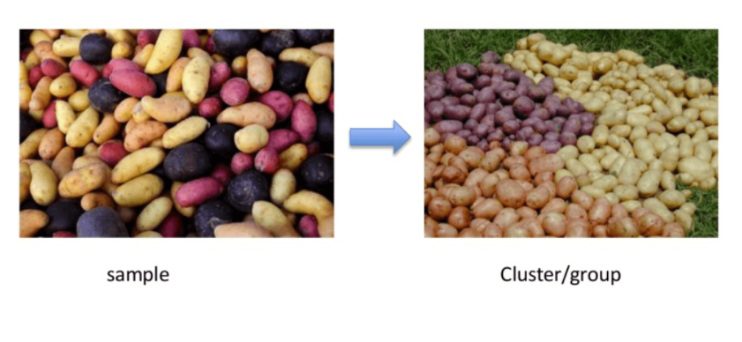
2.Clustering
Clustering is the process of dividing uncategorized data into similar groups or clusters. This process ensures that similar data points are identified and grouped. Clustering algorithms is key in the processing of data and identification of groups (natural clusters).

Slide 18
3]Dimensionality Reduction?
The number of input features, variables, or columns present in a given dataset is known as dimensionality, and the process to reduce these features is called dimensionality reduction.
A dataset contains a huge number of input features in various cases, which makes the predictive modeling task more complicated. Because it is very difficult to visualize or make predictions for the training dataset with a high number of features, for such cases, dimensionality reduction techniques are required to use.
Dimensionality reduction technique can be defined as, "It is a way of converting the higher dimensions dataset into lesser dimensions dataset ensuring that it provides similar information." These techniques are widely used in machine learning for obtaining a better fit predictive model while solving the classification and regression problems.
It is commonly used in the fields that deal with high-dimensional data, such as speech recognition, signal processing, bioinformatics, etc. It can also be used for data visualization, noise reduction, cluster analysis, etc.

Slide 19
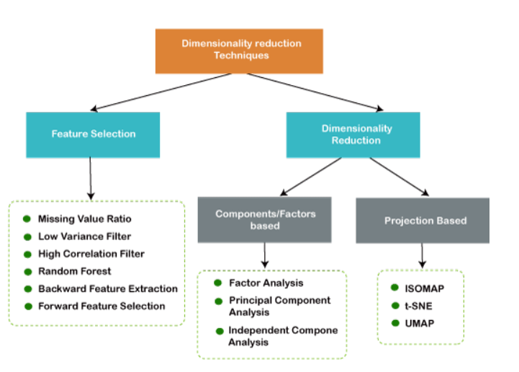
Contd.

Slide 20
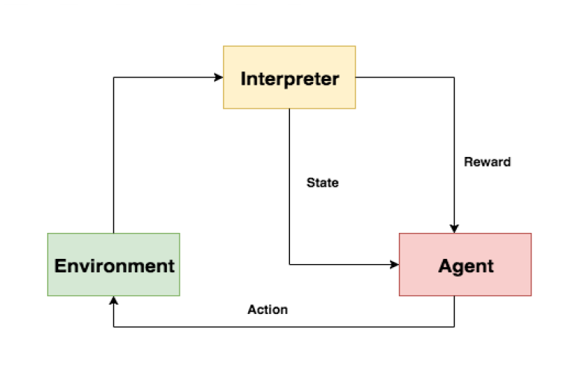
3) Reinforcement Learning
Reinforcement learning is a feedback-based learning method, in which a learning agent gets a reward for each right action and gets a penalty for each wrong action. The agent learns automatically with these feedbacks and improves its performance. In reinforcement learning, the agent interacts with the environment and explores it. The goal of an agent is to get the most reward points, and hence, it improves its performance.
The robotic dog, which automatically learns the movement of his arms, is an example of Reinforcement learning.

Slide 21
Let’s dive in deeper.
Supervised learning algorithms

Slide 22
1. Linear Regression
Linear regression is one of the easiest and most popular Machine Learning algorithms.
It is a statistical method that is used for predictive analysis.
Linear regression makes predictions for continuous/real or numeric variables such as sales, salary, age, product price, etc.
Linear regression algorithm shows a linear relationship between a dependent (X) and one or more independent (y) variables, hence called as linear regression.
Since linear regression shows the linear relationship, which means it finds how the value of the dependent variable is changing according to the value of the independent variable.
The linear regression model provides a sloped straight line representing the relationship between the variables.

Slide 23
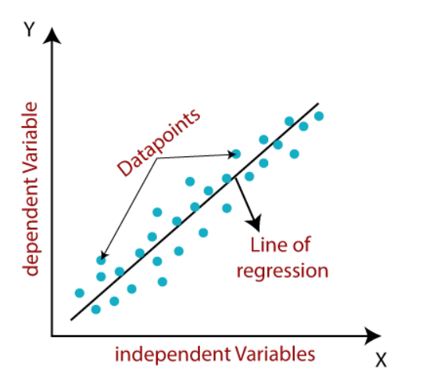
Consider the below image:
Mathematically, we can represent a linear regression as:
y= a₀+a₁x+ ε
Here,
Y= Dependent Variable (Target Variable) X= Independent Variable (predictor Variable) a0= intercept of the line (Gives an additional degree of freedom) a1 = Linear regression coefficient (scale factor to each input value). ε = random error
The values for x and y variables are training datasets for Linear Regression model representation.

Slide 24
Example
Problem Statement example for Simple Linear Regression:
Here we are taking a dataset that has two variables: salary (dependent variable) and experience (Independent variable). The goals of this problem is:
We want to find out if there is any correlation between these two variables
We will find the best fit line for the dataset.
How the dependent variable is changing by changing the independent variable.

Slide 25
2.Logistic Regression
Logistic regression predicts the output of a categorical dependent variable. Therefore the outcome must be a categorical or discrete value. It can be either Yes or No, 0 or 1, true or False, etc. but instead of giving the exact value as 0 and 1, it gives the probabilistic values which lie between 0 and 1.
The general mathematical equation for logistic regression is −
y = 1/(1+e^-(a+b1x1+b2x2+b3x3+...))
Following is the description of the parameters used −
• y is the response variable.
• x is the predictor variable.
• a and b are the coefficients which are numeric constants.

Slide 26
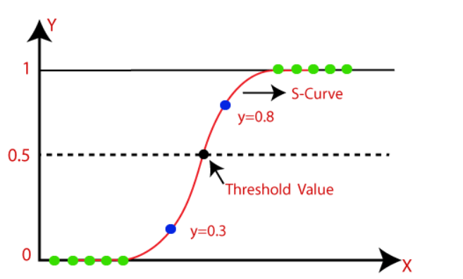
Representation
The sigmoid function is a mathematical function used to map the predicted values to probabilities.
It maps any real value into another value within a range of 0 and 1.
The value of the logistic regression must be between 0 and 1, which cannot go beyond this limit, so it forms a curve like the "S" form. The S-form curve is called the Sigmoid function or the logistic function.
In logistic regression, we use the concept of the threshold value, which defines the probability of either 0 or 1. Such as values above the threshold value tends to 1, and a value below the threshold values tends to 0.

Slide 27
Example
Example: There is a dataset given which contains the information of various users obtained from the social networking sites. There is a car making company that has recently launched a new SUV car. So the company wanted to check how many users from the dataset, wants to purchase the car.
For this problem, we will build a Machine Learning model using the Logistic regression algorithm. The dataset is shown in the below image. In this problem, we will predict the purchased variable (Dependent Variable) by using age and salary (Independent variables).
Steps in Logistic Regression: To implement the Logistic Regression using Python, we will use the same steps as we have done in previous topics of Regression. Below are the steps:
Data Pre-processing step
Fitting Logistic Regression to the Training set
Predicting the test result
Test accuracy of the result(Creation of Confusion matrix)
Visualizing the test set result.

Slide 28
3.CART( Classification and Regression tree)
CART is an umbrella word that refers to the following types of decision trees:
Classification Trees: When the target variable is continuous, the tree is used to find the "class" into which the target variable is most likely to fall.
Regression trees: These are used to forecast the value of a continuous variable.

Slide 29
Decision Tree Classification Algorithm
Decision Tree is a Supervised learning technique that can be used for both classification and Regression problems, but mostly it is preferred for solving Classification problems. It is a tree-structured classifier, where internal nodes represent the features of a dataset, branches represent the decision rules and each leaf node represents the outcome.
In a Decision tree, there are two nodes, which are the Decision Node and Leaf Node. Decision nodes are used to make any decision and have multiple branches, whereas Leaf nodes are the output of those decisions and do not contain any further branches.
The decisions or the test are performed on the basis of features of the given dataset.
A decision tree simply asks a question, and based on the answer (Yes/No), it further split the tree into subtrees.

Slide 30
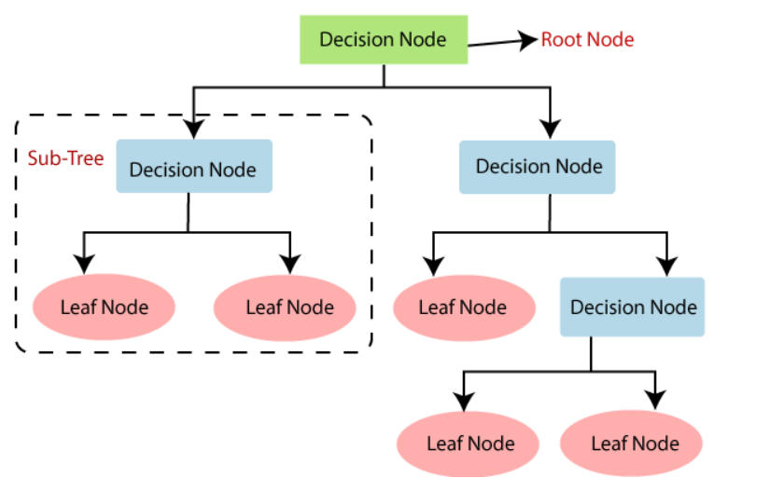
Representation
Decision Tree Terminologies
Root Node: Root node is from where the decision tree starts. It represents the entire dataset, which further gets divided into two or more homogeneous sets.
Leaf Node: Leaf nodes are the final output node, and the tree cannot be segregated further after getting a leaf node.
Splitting: Splitting is the process of dividing the decision node/root node into sub-nodes according to the given conditions.
Branch/Sub Tree: A tree formed by splitting the tree.
Pruning: Pruning is the process of removing the unwanted branches from the tree.
Parent/Child node: The root node of the tree is called the parent node, and other nodes are called the child nodes.

Slide 31
How does the Decision Tree algorithm Work?
Step-1: Begin the tree with the root node, says S, which contains the complete dataset.
Step-2: Find the best attribute in the dataset using Attribute Selection Measure (ASM).
Step-3: Divide the S into subsets that contains possible values for the best attributes.
Step-4: Generate the decision tree node, which contains the best attribute.
Step-5: Recursively make new decision trees using the subsets of the dataset created in step -3. Continue this process until a stage is reached where you cannot further classify the nodes and called the final node as a leaf node.

Slide 32
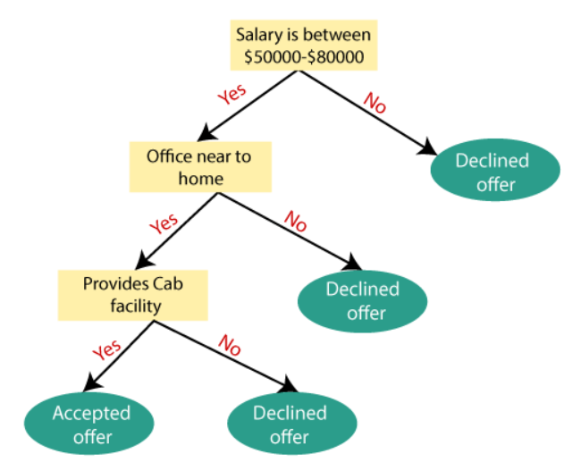
Example
Example: Suppose there is a candidate who has a job offer and wants to decide whether he should accept the offer or Not. So, to solve this problem, the decision tree starts with the root node (Salary attribute by ASM). The root node splits further into the next decision node (distance from the office) and one leaf node based on the corresponding labels. The next decision node further gets split into one decision node (Cab facility) and one leaf node. Finally, the decision node splits into two leaf nodes (Accepted offers and Declined offer). Consider the below diagram:
For implementing the Decision tree using Python. We will use the dataset "user_data.csv," which we have used in previous classification models.

Slide 33
4.Naïve Bayes
Naïve Bayes algorithm is a supervised learning algorithm, which is based on Bayes theorem and used for solving classification problems.
It is mainly used in text classification that includes a high-dimensional training dataset.
Naïve Bayes Classifier is one of the simple and most effective Classification algorithms which helps in building the fast machine learning models that can make quick predictions.
It is a probabilistic classifier, which means it predicts on the basis of the probability of an object.
Some popular examples of Naïve Bayes Algorithm are spam filtration, Sentimental analysis, and classifying articles.

Slide 34

Bayes' Theorem:
Bayes' theorem is also known as Bayes' Rule or Bayes' law, which is used to determine the probability of a hypothesis with prior knowledge. It depends on the conditional probability.
The formula for Bayes' theorem is given as:
Where,
P(A|B) is Posterior
probability: Probability of hypothesis A on the observed event B.
P(B|A) is Likelihood probability: Probability of the evidence given that the probability of a hypothesis is true.
P(A) is Prior Probability: Probability of hypothesis before observing the evidence.
P(B) is Marginal Probability: Probability of Evidence.

Slide 35
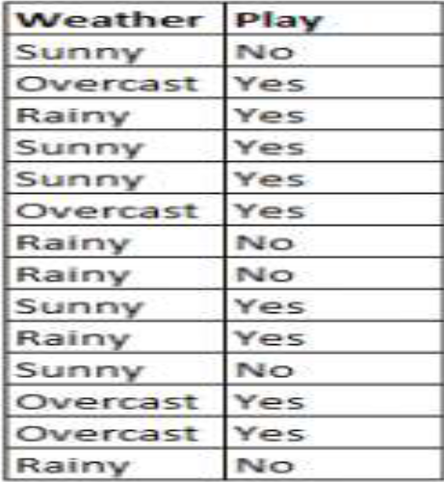
Lets look into this example and apply the bayes theorem.
Using Naive Bayes to predict the status of ‘play’ using the variable ‘weather’
what is the outcome if weather=’sunny’?
To determine the outcome play= ‘yes’ or ‘no’ given the value of variable weather=’sunny’, calculate
P(yes|sunny) and P(no|sunny) and choose the outcome with higher probability.
->P(yes|sunny)= (P(sunny|yes) * P(yes)) / P(sunny)
= (3/9 * 9/14 ) / (5/14)
= 0.60
-> P(no|sunny)= (P(sunny|no) * P(no)) / P(sunny)
= (2/5 * 5/14 ) / (5/14)
= 0.40
Thus, if the weather =’sunny’, the outcome is play= ‘yes’.
we will use the "user_data" dataset, which we have used in our other classification model

Slide 36
5.KNN
K-Nearest Neighbour is one of the simplest Machine Learning algorithms based on Supervised Learning technique.
K-NN algorithm assumes the similarity between the new case/data and available cases and put the new case into the category that is most similar to the available categories.
K-NN algorithm stores all the available data and classifies a new data point based on the similarity. This means when new data appears then it can be easily classified into a well suite category by using K- NN algorithm.
K-NN algorithm can be used for Regression as well as for Classification but mostly it is used for the Classification problems.
K-NN is a non-parametric algorithm, which means it does not make any assumption on underlying data.
It is also called a lazy learner algorithm because it does not learn from the training set immediately instead it stores the dataset and at the time of classification, it performs an action on the dataset.
KNN algorithm at the training phase just stores the dataset and when it gets new data, then it classifies that data into a category that is much similar to the new data.

Slide 37
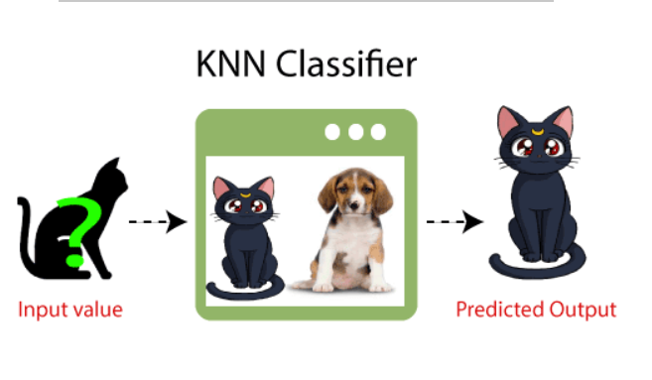
Example
Suppose, we have an image of a creature that looks similar to cat and dog, but we want to know either it is a cat or dog. So for this identification, we can use the KNN algorithm, as it works on a similarity measure. Our KNN model will find the similar features of the new data set to the cats and dogs images and based on the most similar features it will put it in either cat or dog category.

Slide 38
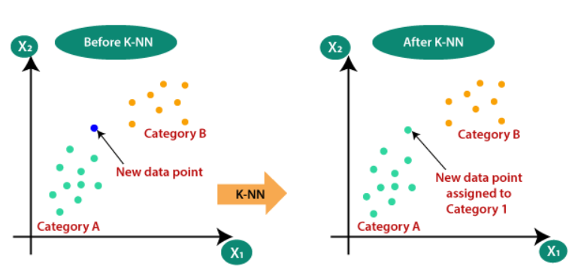
Why do we need a K-NN Algorithm?
Suppose there are two categories, i.e., Category A and Category B, and we have a new data point x1, so this data point will lie in which of these categories. To solve this type of problem, we need a K-NN algorithm. With the help of K-NN, we can easily identify the category or class of a particular dataset. Consider the below diagram:

Slide 39
How does K-NN work?
The K-NN working can be explained on the basis of the below algorithm:
Step-1: Select the number K of the neighbors
Step-2: Calculate the Euclidean distance of K number of neighbors
Step-3: Take the K nearest neighbors as per the calculated Euclidean distance.
Step-4: Among these k neighbors, count the number of the data points in each category.
Step-5: Assign the new data points to that category for which the number of the neighbor is maximum.
Step-6: Our model is ready.

Slide 40
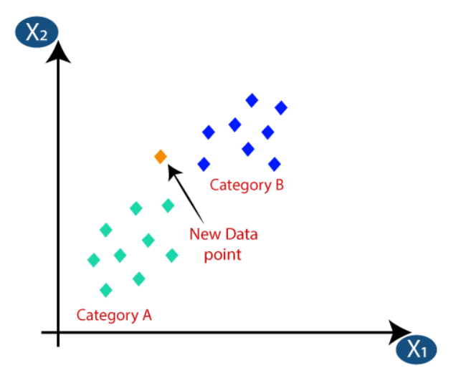
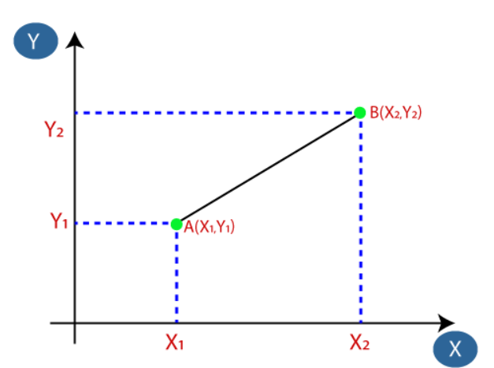
Consider the below image:
Firstly, we will choose the number of neighbors, so we will choose the k=5.
Next, we will calculate the Euclidean distance between the data points. The Euclidean distance is the distance between two points, which we have already studied in geometry. It can be calculated as:

Slide 41

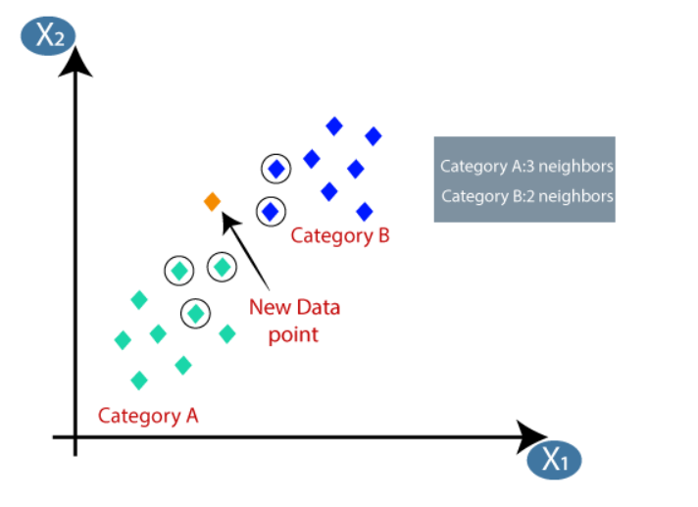
contd
As we can see the 3 nearest neighbors are from category A, hence this new data point must belong to category A.
Problem for K-NN Algorithm: There is a Car manufacturer company that has manufactured a new SUV car. The company wants to give the ads to the users who are interested in buying that SUV. So for this problem, we have a dataset that contains multiple user's information through the social network. The dataset contains lots of information but the Estimated Salary and Age we will consider for the independent variable and the Purchased variable is for the dependent variable.

Slide 42
Unsupervised learning algorithms

Slide 43
1. Apriori
The Apriori algorithm is used in a transactional database to mine frequent itemsets and then
generate association rules.
• It is popularly used in market basket analysis, where one checks for combinations of products that
frequently co-occur in the database.
• In general, we write the association rule for ‘if a person purchases item X, then he purchases item Y’
as : X -> Y.
if a person purchases milk and sugar, then he is likely to purchase coffee powder. This could be
written in the form of an association rule as: {milk,sugar} -> coffee powder. Association rules are generated after crossing the threshold for support and confidence

Slide 44
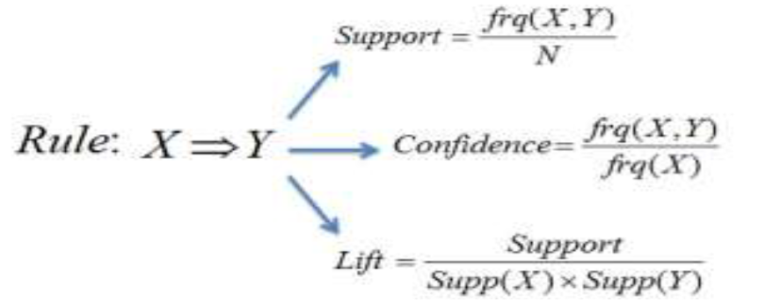
Formula
The Support measure helps prune the number of candidate itemsets to be considered during
frequent itemset generation.
This support measure is guided by the Apriori principle.
The Apriori principle states that if an itemset is frequent, then all of its subsets must also be frequent

Slide 45
2.K-Means
K-Means Clustering is an Unsupervised Learning algorithm, which groups the unlabeled dataset into different clusters. Here K defines the number of pre-defined clusters that need to be created in the process, as if K=2, there will be two clusters, and for K=3, there will be three clusters, and so on.
It allows us to cluster the data into different groups and a convenient way to discover the categories of groups in the unlabeled dataset on its own without the need for any training.
It is a centroid-based algorithm, where each cluster is associated with a centroid. The main aim of this algorithm is to minimize the sum of distances between the data point and their corresponding clusters.
The k-means clustering algorithm mainly performs two tasks:
Determines the best value for K center points or centroids by an iterative process.
Assigns each data point to its closest k-center. Those data points which are near to the particular k-center, create a cluster.

Slide 46
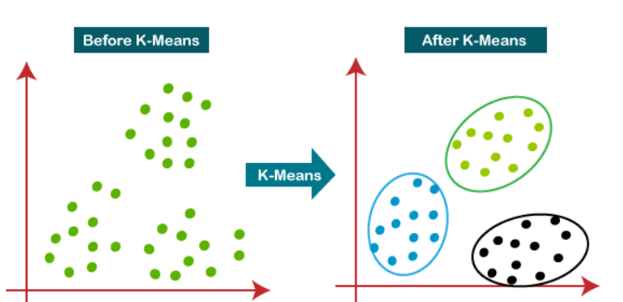
The working of the K-means Clustering Algorithm:
The working of the K-Means algorithm is explained in the below steps:
Step-1: Select the number K to decide the number of clusters.
Step-2: Select random K points or centroids. (It can be other from the input dataset).
Step-3: Assign each data point to their closest centroid, which will form the predefined K clusters.
Step-4: Calculate the variance and place a new centroid of each cluster.
Step-5: Repeat the third steps, which means reassign each datapoint to the new closest centroid of each cluster.
Step-6: If any reassignment occurs, then go to step-4 else go to FINISH.
Step-7: The model is ready.

Slide 47
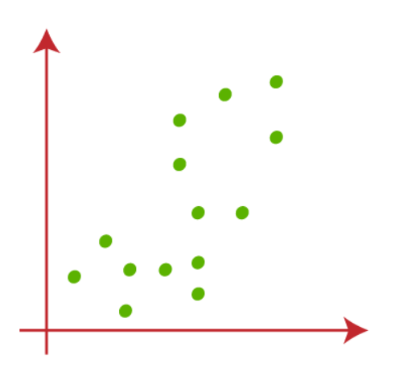
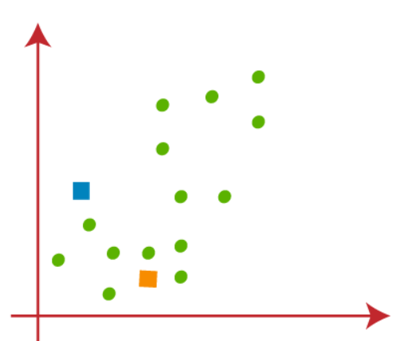
Let's understand the above steps by considering the visual plots:
Suppose we have two variables M1 and M2. The x-y axis scatter plot of these two variables is given below:
Let's take number k of clusters, i.e., K=2, to identify the dataset and to put them into different clusters. It means here we will try to group these datasets into two different clusters.
We need to choose some random k points or centroid to form the cluster. These points can be either the points from the dataset or any other point. So, here we are selecting the below two points as k points, which are not the part of our dataset. Consider the below image:

Slide 48
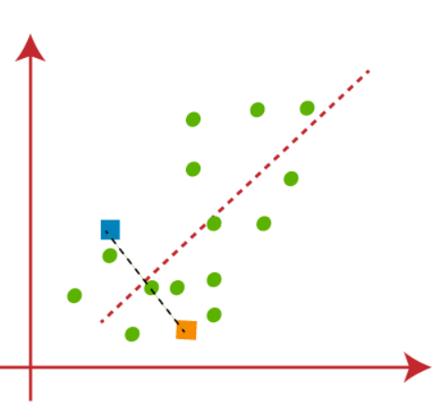
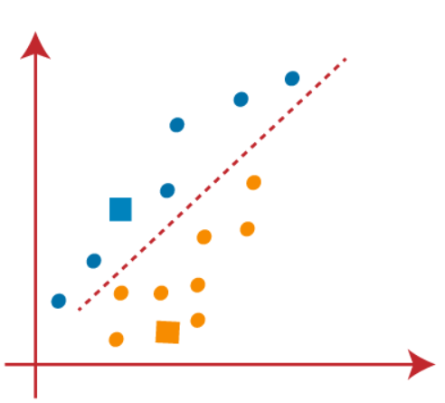
contd
Now we will assign each data point of the scatter plot to its closest K-point or centroid. We will compute it by applying some mathematics that we have studied to calculate the distance between two points. So, we will draw a median between both the centroids. Consider the below image:
From the above image, it is clear that points left side of the line is near to the K1 or blue centroid, and points to the right of the line are close to the yellow centroid. Let's color them as blue and yellow for clear visualization.

Slide 49
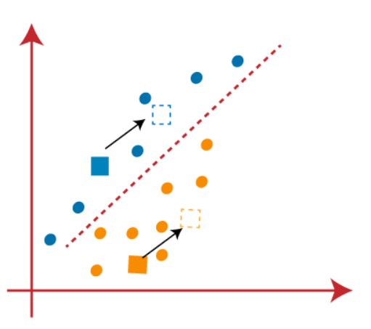
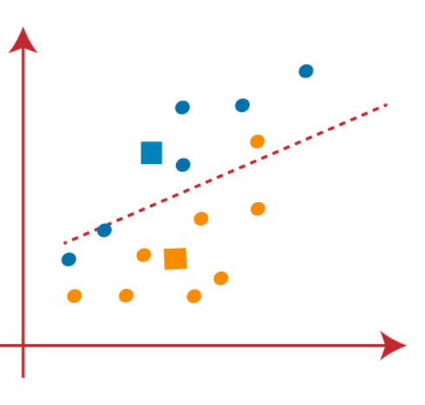
contd
As we need to find the closest cluster, so we will repeat the process by choosing a new centroid. To choose the new centroids, we will compute the center of gravity of these centroids, and will find new centroids as below:
Next, we will reassign each datapoint to the new centroid. For this, we will repeat the same process of finding a median line. The median will be like below image

Slide 50
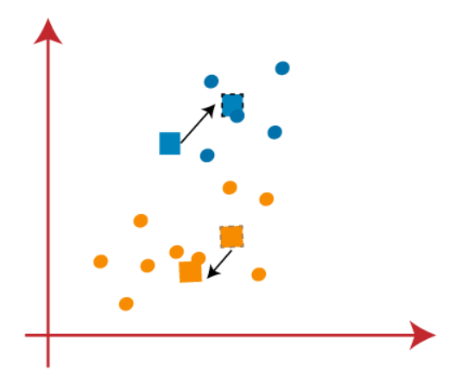
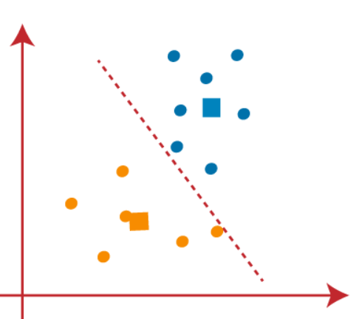
contd
As reassignment has taken place, so we will again go to the step-4, which is finding new centroids or K-points.
We will repeat the process by finding the center of gravity of centroids, so the new centroids will be as shown in the below image:
As we got the new centroids so again will draw the median line and reassign the data points. So, the image will be:

Slide 51
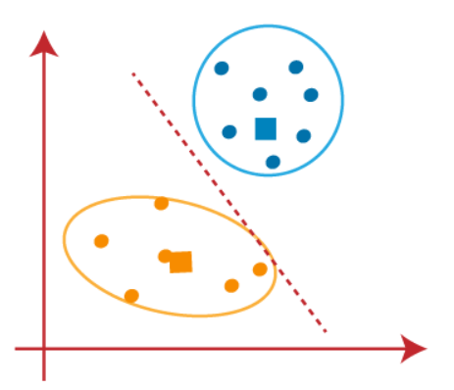
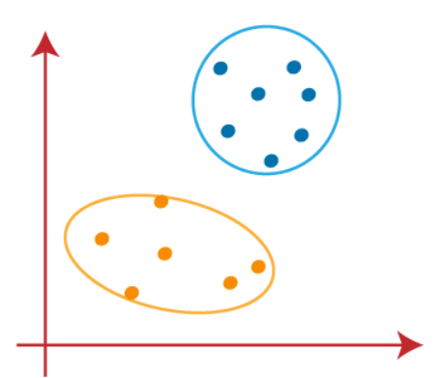
contd
We can see in the above image; there are no dissimilar data points on either side of the line, which means our model is formed. Consider the below image:
As our model is ready, so we can now remove the assumed centroids, and the two final clusters will be as shown in the below image:

Slide 52
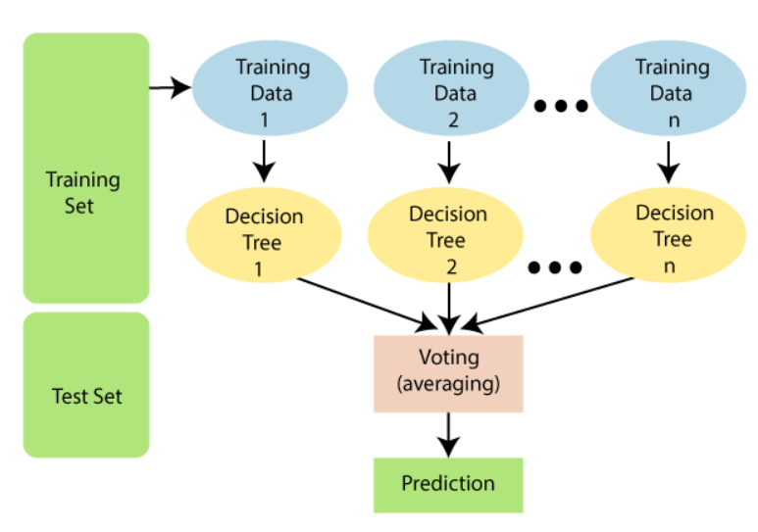
3. Random Forest Algorithm(Ensemble)
"Random Forest is a classifier that contains a number of decision trees on various subsets of the given dataset and takes the average to improve the predictive accuracy of that dataset." Instead of relying on one decision tree, the random forest takes the prediction from each tree and based on the majority votes of predictions, and it predicts the final output.

Slide 53
How does Random Forest algorithm work?
Random Forest works in two-phase first is to create the random forest by combining N decision tree, and second is to make predictions for each tree created in the first phase.
The Working process can be explained in the below steps and diagram:
Step-1: Select random K data points from the training set.
Step-2: Build the decision trees associated with the selected data points (Subsets).
Step-3: Choose the number N for decision trees that you want to build.
Step-4: Repeat Step 1 & 2.
Step-5: For new data points, find the predictions of each decision tree, and assign the new data points to the category that wins the majority votes.

Slide 54
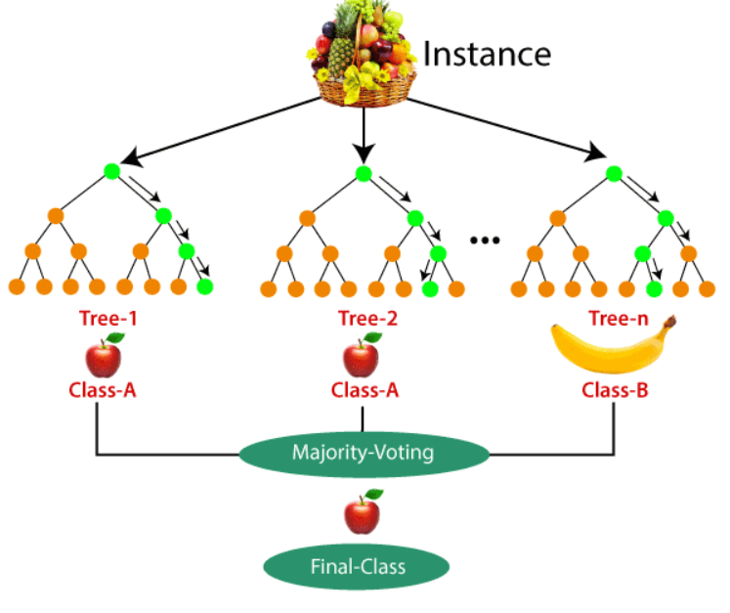
Example
Suppose there is a dataset that contains multiple fruit images. So, this dataset is given to the Random forest classifier. The dataset is divided into subsets and given to each decision tree. During the training phase, each decision tree produces a prediction result, and when a new data point occurs, then based on the majority of results, the Random Forest classifier predicts the final decision. Consider the below image:

